Slide 1
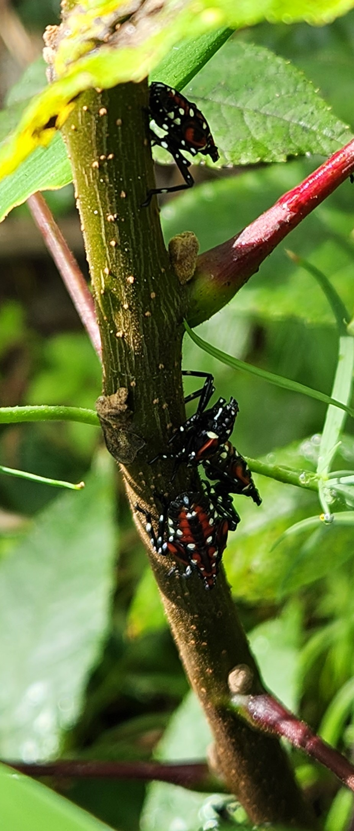
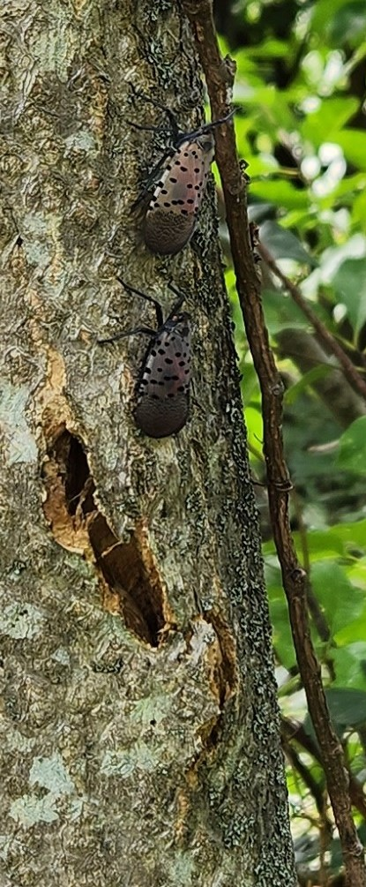
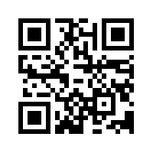


Spotted Lantern Fly in the Hudson Valley
Round Table Discussion:
Identifying SLF
Where to scout
What it means for your vineyard and winery
How to manage SLF
When: September 7th at 2:00 pm
Where: In person at Hudson Valley Research Lab
or
Zoom:
https://cornell.zoom.us/j/99896574465?pwd=L080QWFmeGc0ZldVUDRHb1NLclphdz09
*Round table discussion will be recorded

Slide 2


Guest Speakers
Cain Hickey
Extension Educator, Viticulturist
Penn State Extension
Brian Walsh
Extension Educator, Ornamentals
Penn State Extension

Slide 3
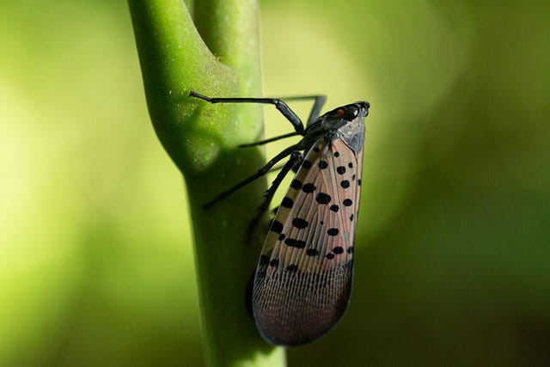
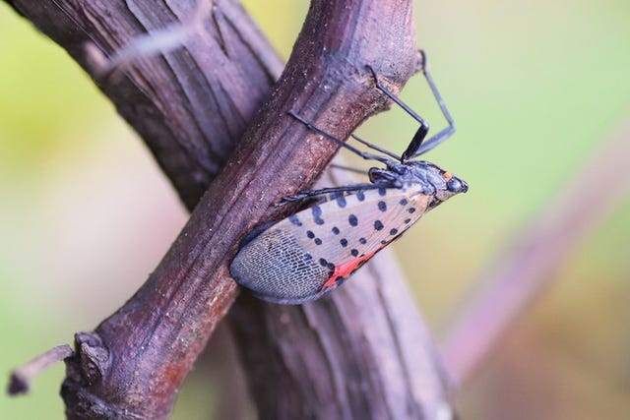
Important Spotted Lanternfly Management Guides
Spotted Lanternfly Management Guide from Penn State Extension
Spotted Lanternfly Management in Vineyards from Penn State Extension
Photo Credit: Penn State Extension

Slide 4
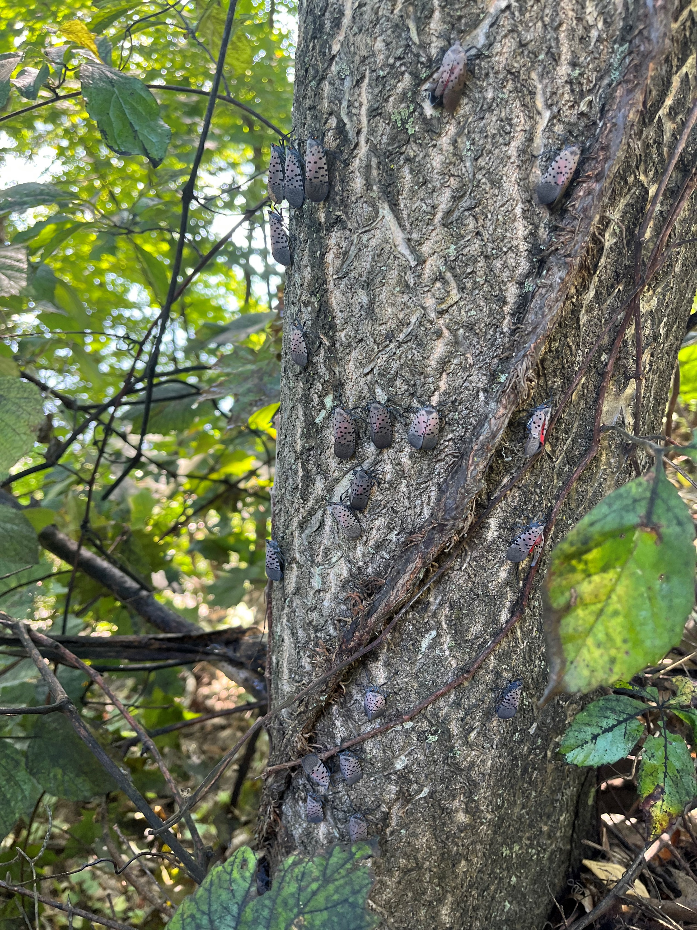
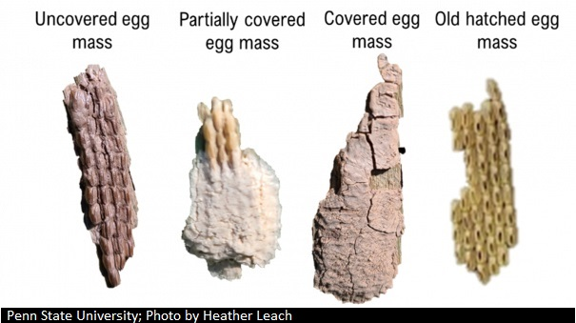
Identifying Spotted Lantern Fly
How many do you see?
Photo Credit: Cornell University, Hannah Tolz
Photo Credit: Penn State University, Heather Leach

Slide 5
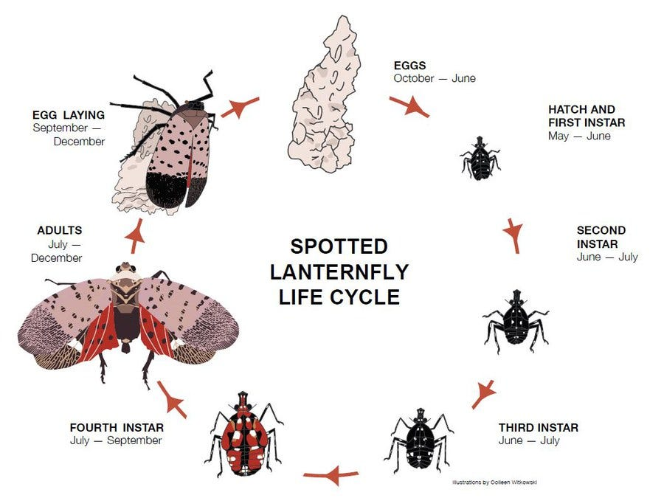
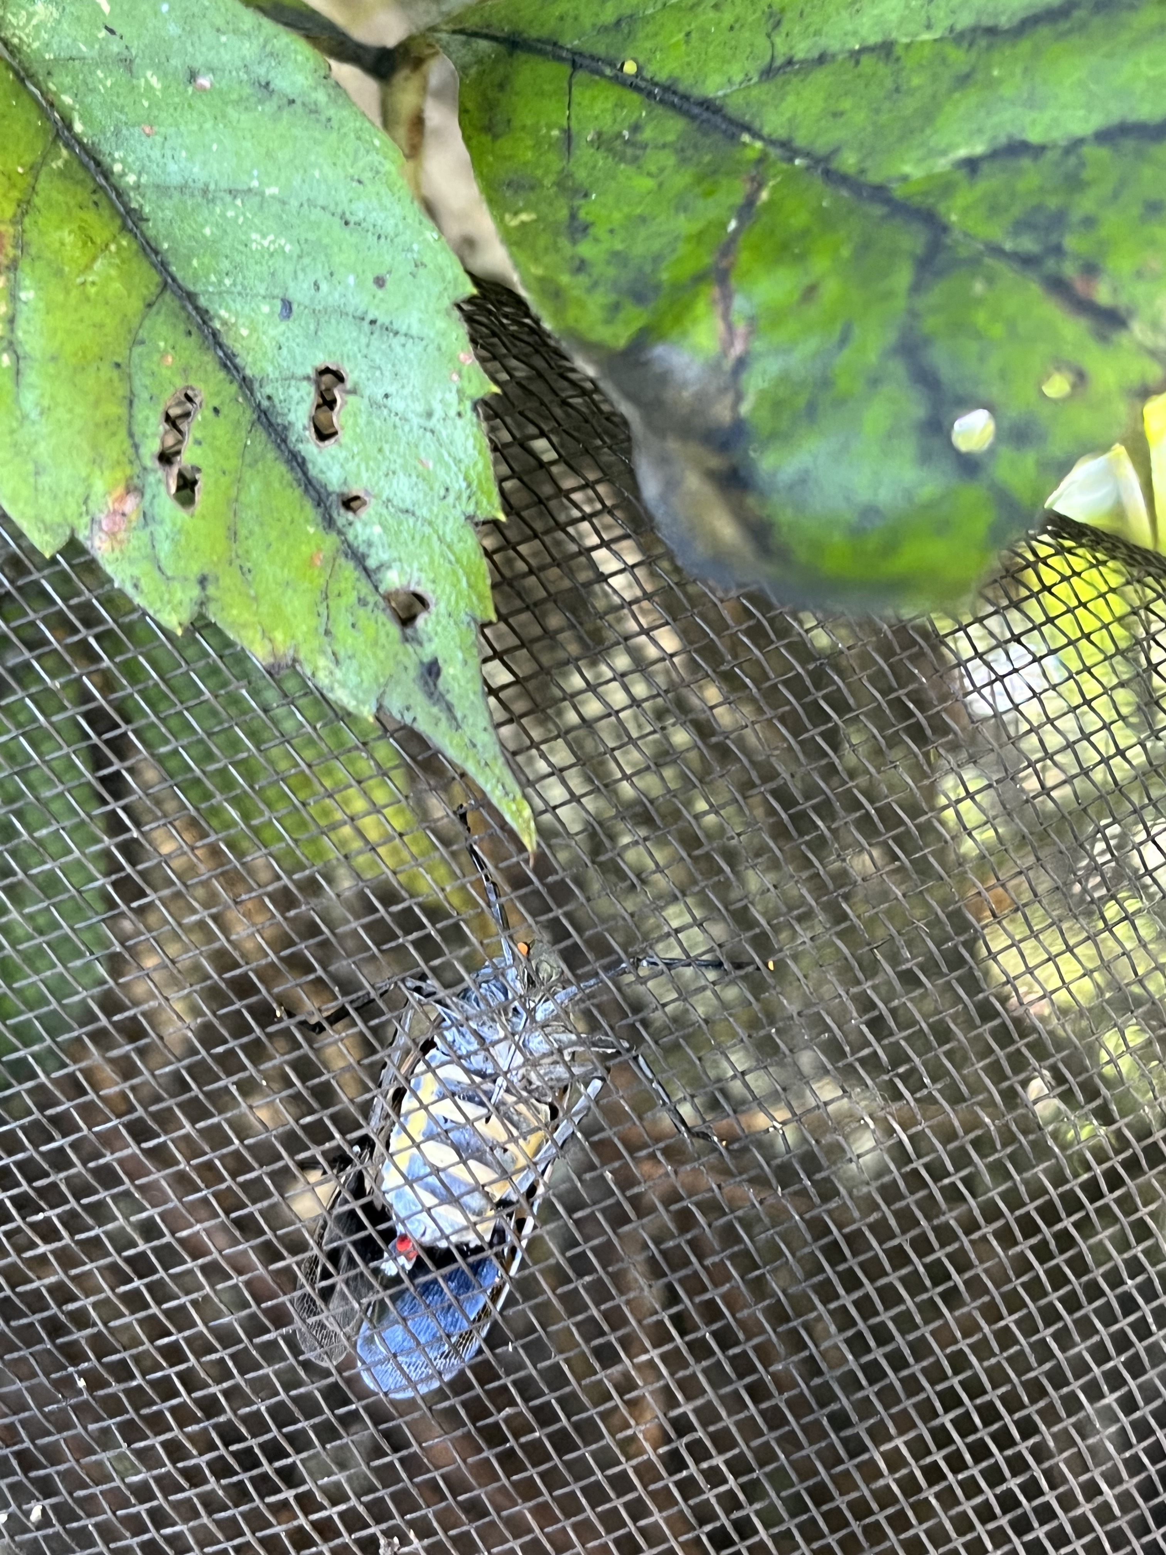
Spotted Lanternfly Life Stages
Photo Credit: Cornell University, Hannah Tolz
Illustration credit: Colleen Witkowski

Slide 6
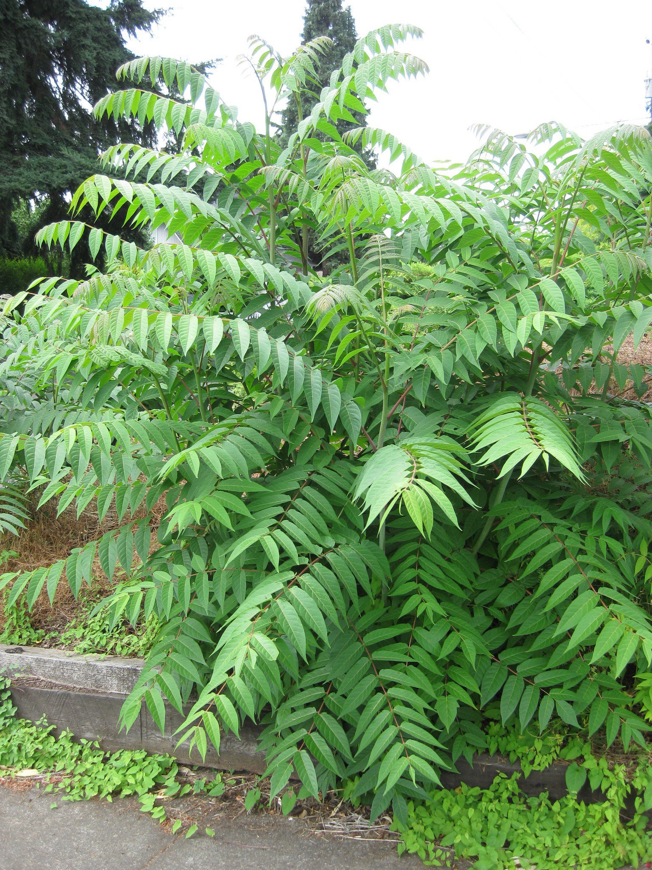
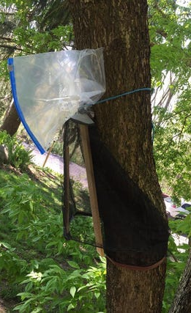
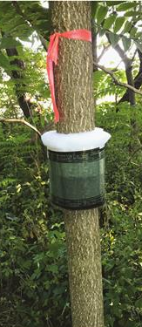
Where to look for Spotted Lanternfly
Tree of Heaven
Circle Trap
Bug Barrier Tree Band
Photo Credit: City Green blog, Portland Bureau of Environmental Services, Oregon
Photo Credit: Penn State, Emelie Swackhamer
Photo Credit: Francese et al. 2020

Slide 7
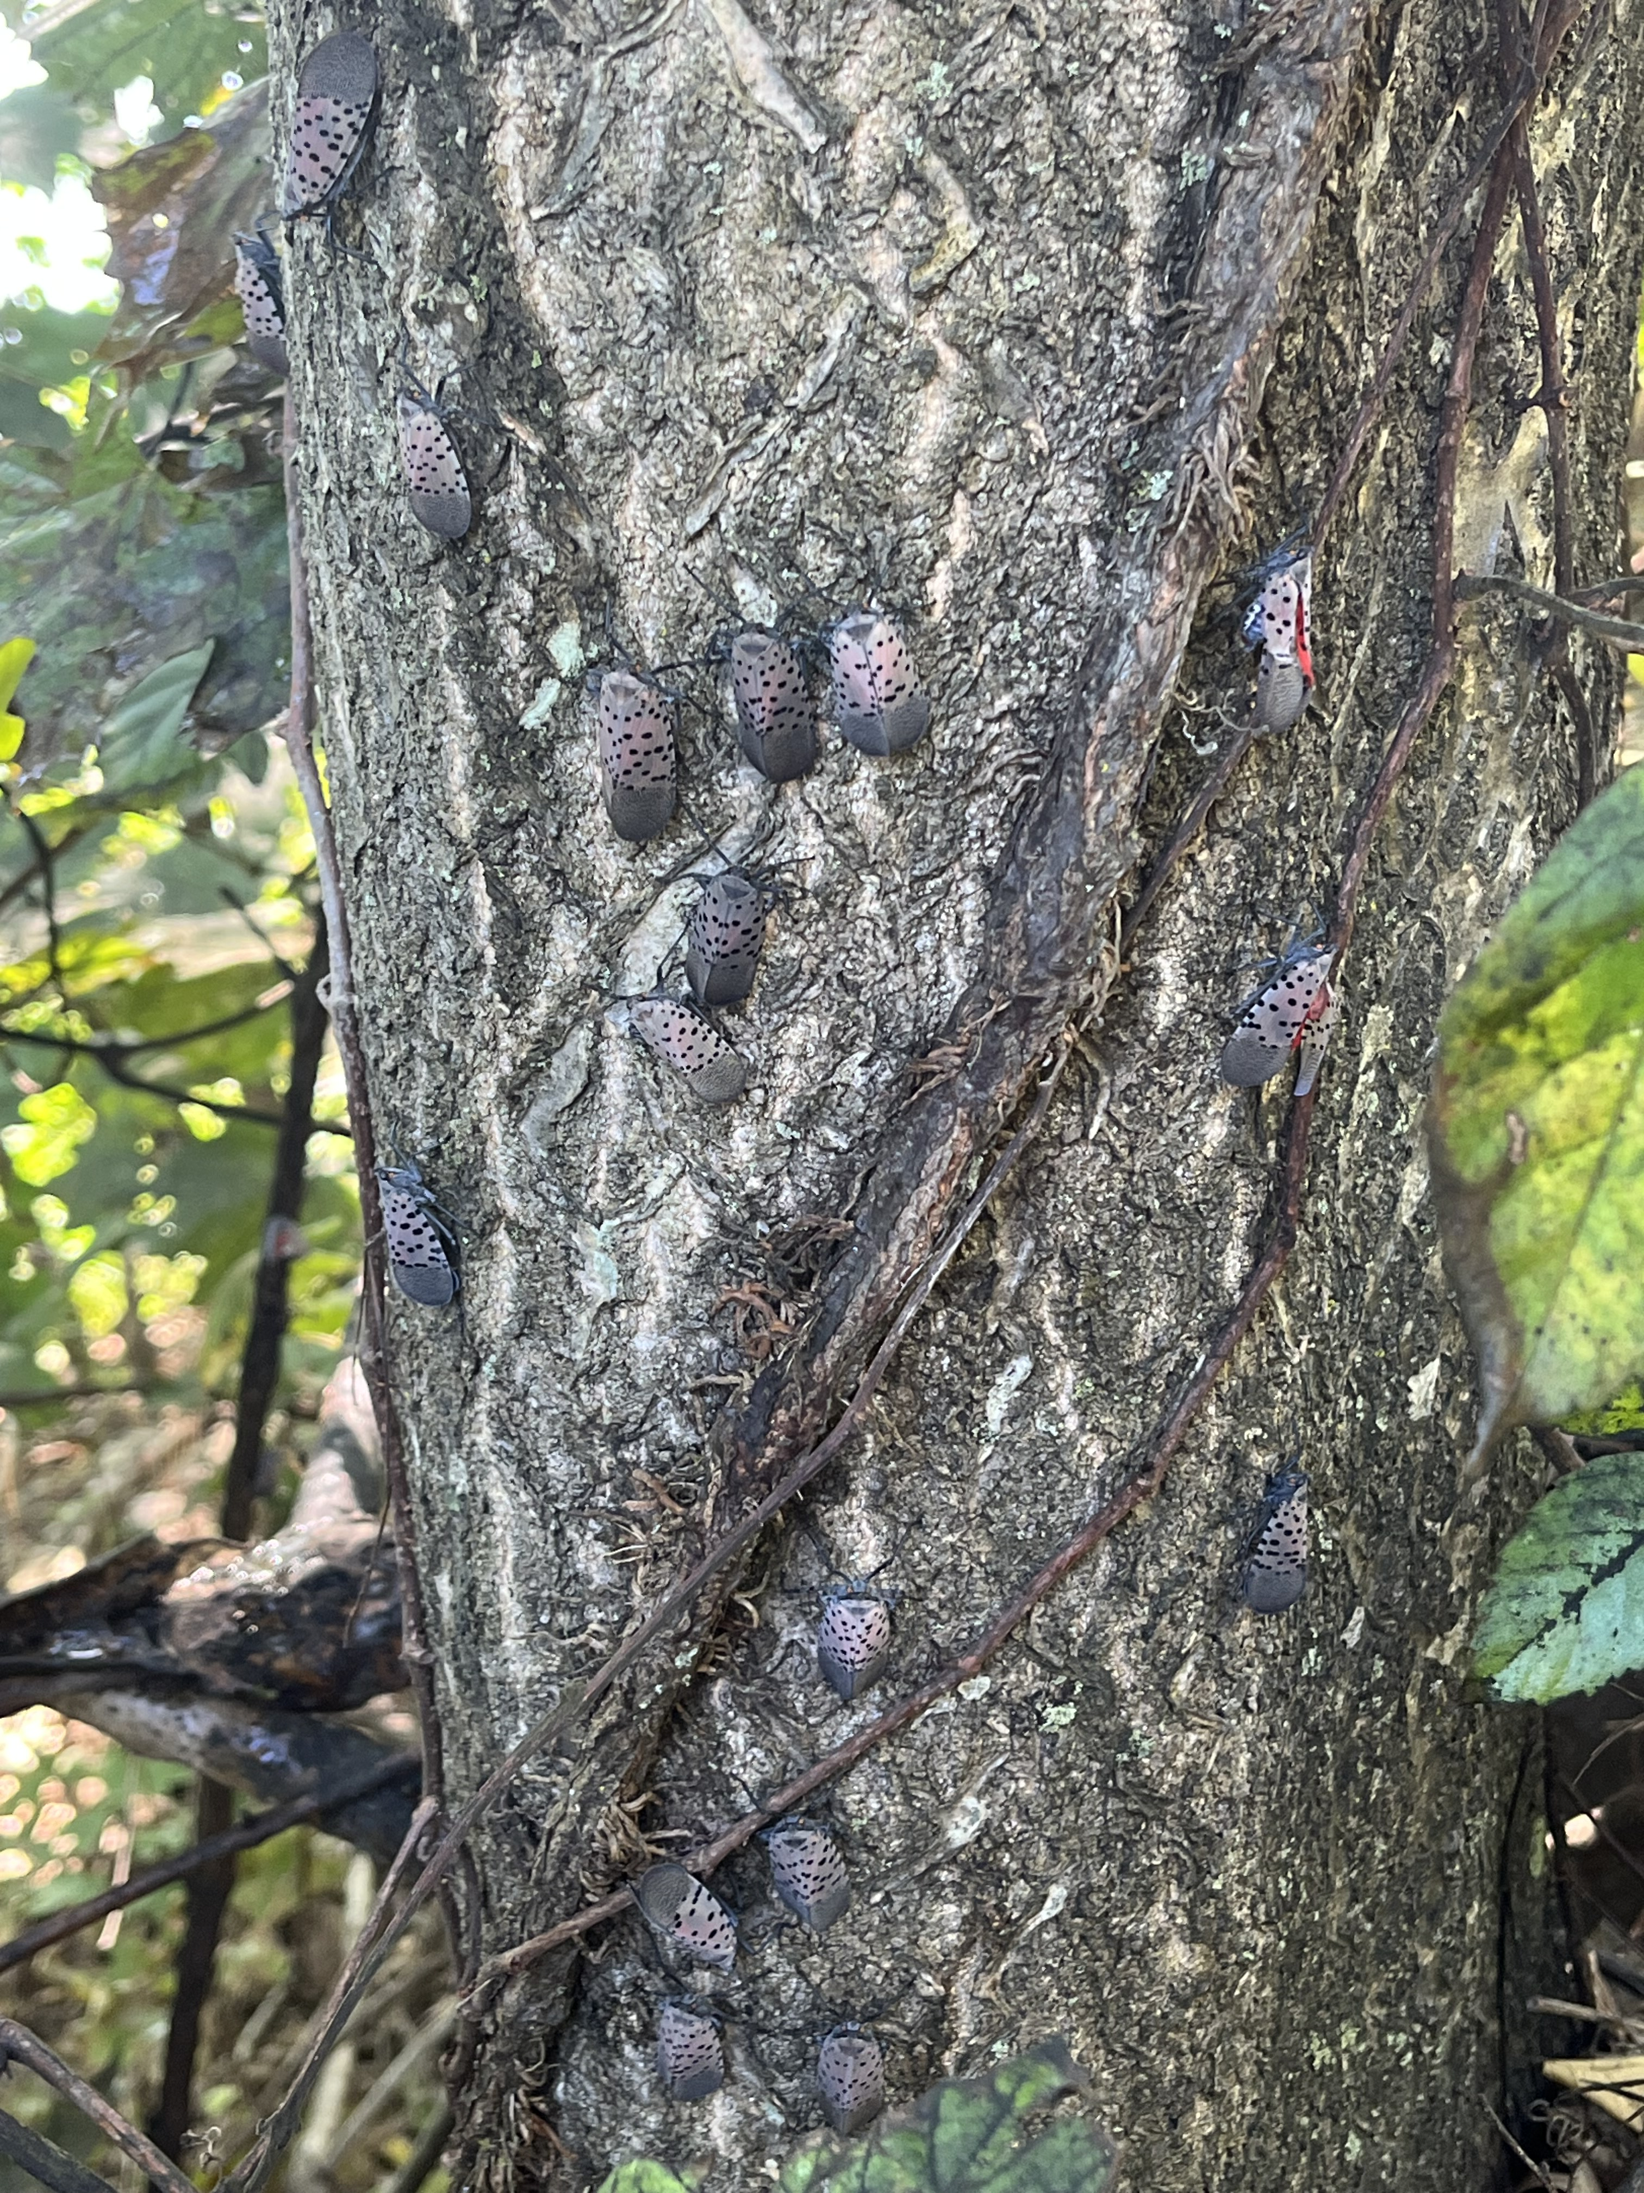
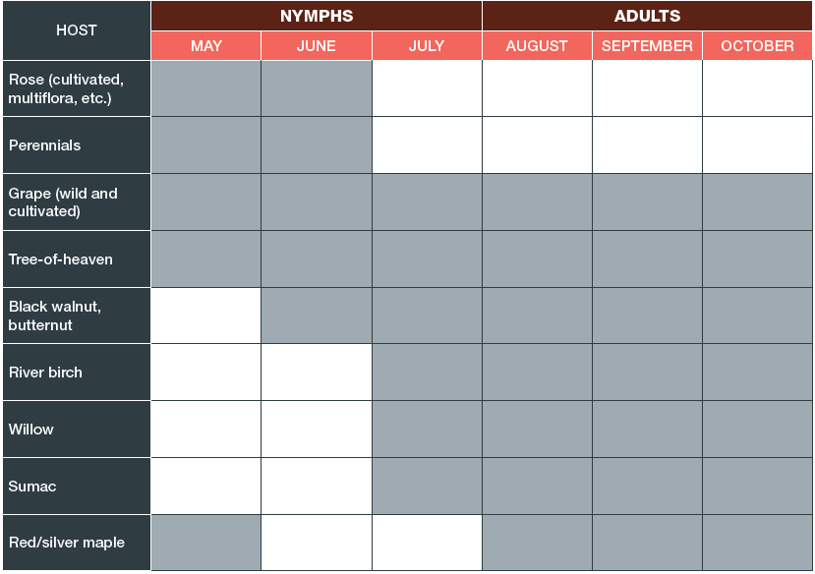
Where and when to find Spotted Lanternfly
Table Credit: Penn State Extension

Slide 8
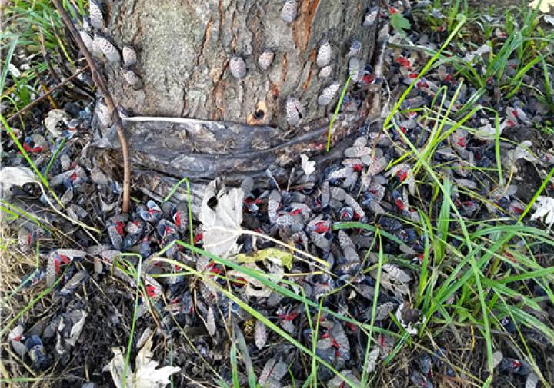
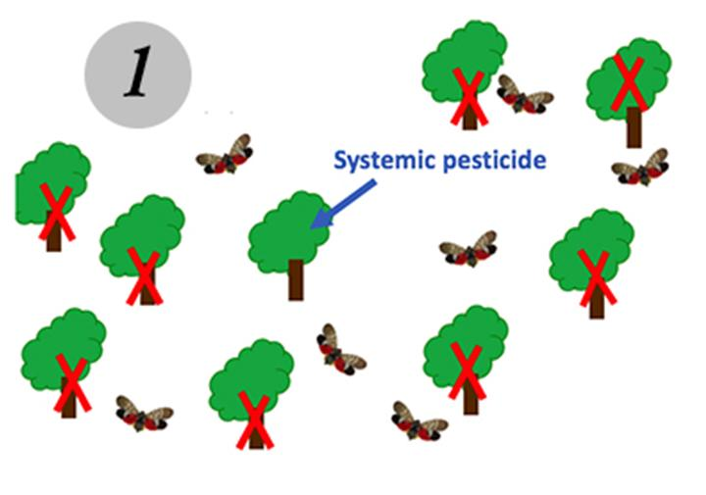
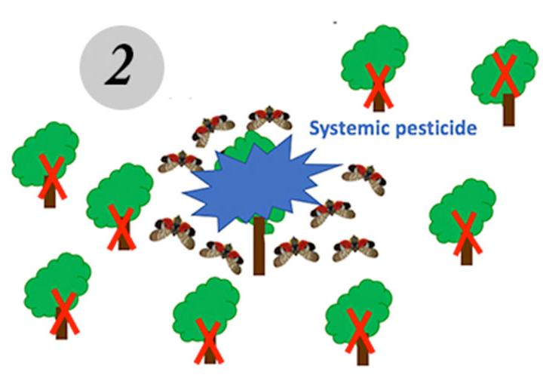
Management of Spotted Lanternfly
Insecticides
  Commercial and Home Garden use
  Grapes
  Trap trees
Cultural controls
  Removal of Tree of Heaven
  Destruction of SLF egg masses
  Traps
  Vacuum Removal
Photo Credit: Cornell CALS, New York State IPM
Photo Credit: Cornell CALS, New York State IPM

Slide 9
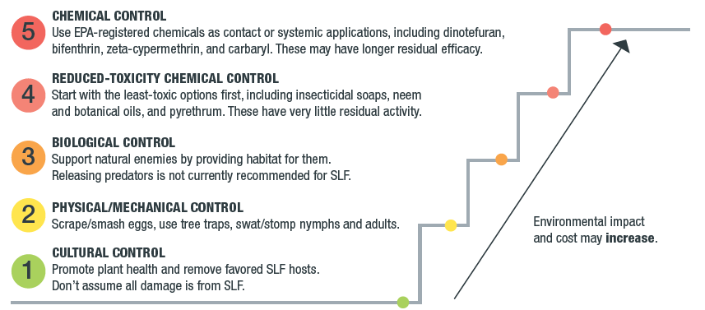
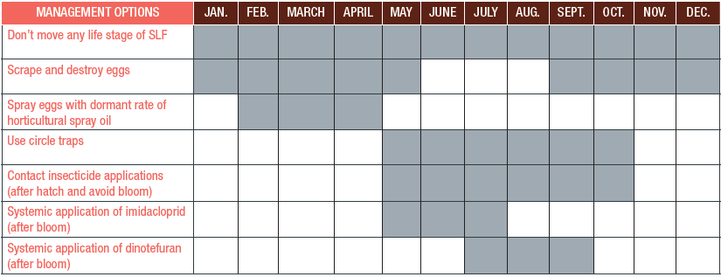
Management of Spotted Lanternfly:
When and how?
Image Credits: Penn State Extension

Slide 10
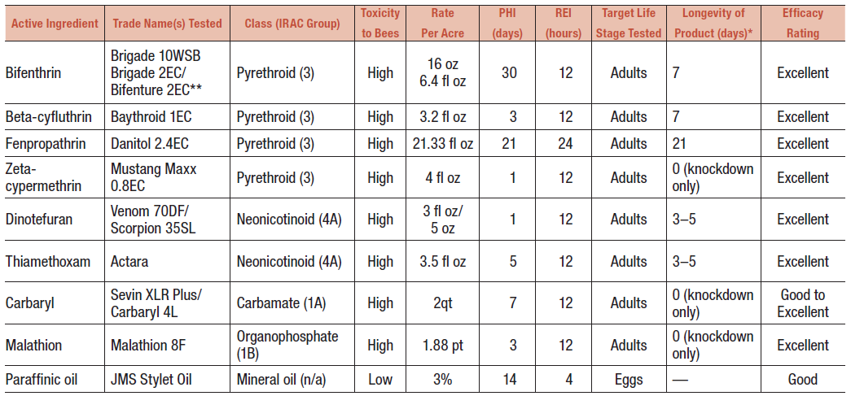
Insecticides for Spotted Lanternfly
*Consult with label before applying
Table Credit: Penn State Extension

Slide 11
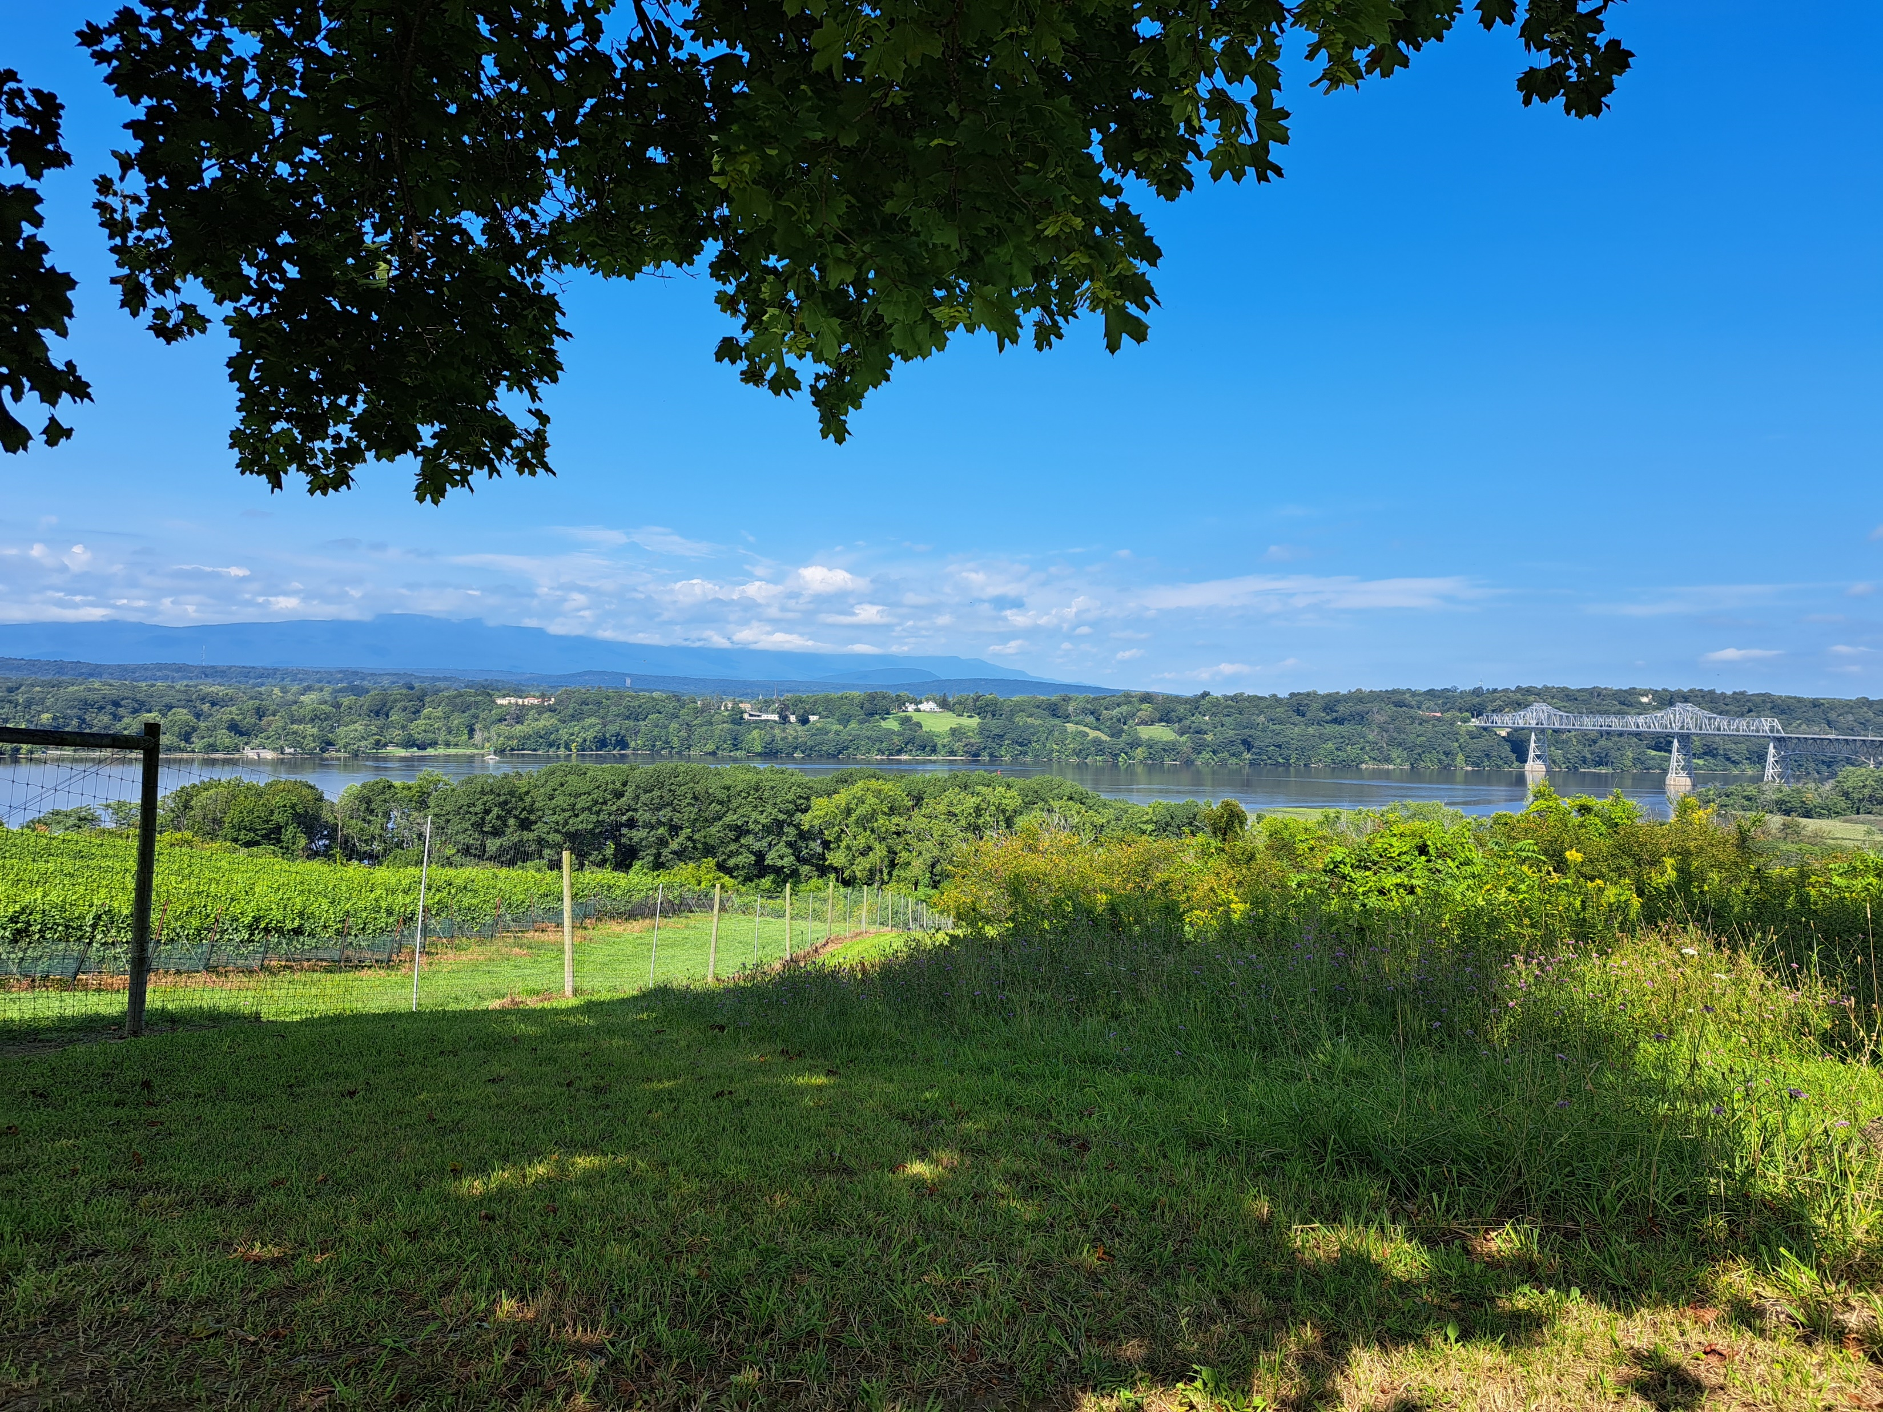
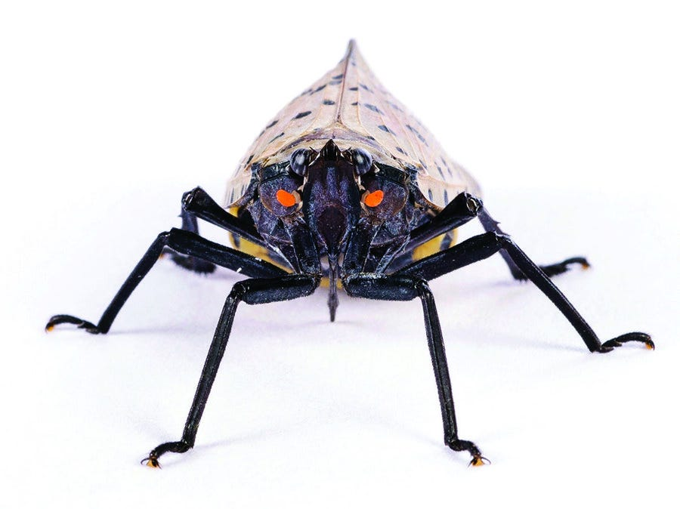

What does this mean for your winery/tasting room/vineyard?
Photo Credit: GH Photos Alamy Stock

Slide 12
Resources
Spotted Lanternfly: What to Look for
Tree-of-Heaven
How to Build a Spotted Lanternfly Circle Trap
Developing Traps for the Spotted Lanternfly
Spotted Lanternfly Management Guide
Spotted Lanternfly Management in vineyards
New York registered Insecticides labeled for Spotted Lanternfly (Commercial and Home Garden)
New York registered Insecticides labeled for Spotted Lanternfly (Grapes)
Dinotefuran Label
Tree of Heaven: Control Strategies

Slide 13
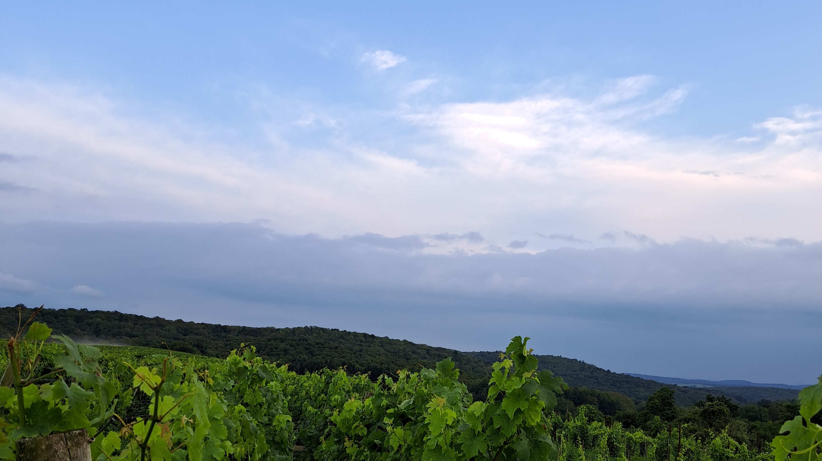

Additional Questions?
  Jeremy Schuster
  Viticulture Extension Specialist
  ENYCHP
Reach out to me at:
  jds544@cornell.edu
  Mobile: 845-372-4780
  3357 US Highway 9W
  Highland, NY 12528

Slide 14
Seen Spotted Lanternfly?
Report it!
Please fill out the Spotted Lanternfly Tracking Survey to track the spread and severity of spotted lanternfly populations.
Results will be automatically displayed on the SLF Map 2023 of the Eastern U.S.
To learn more about the tracking survey, click here
Curiosity of our viticulture colleagues at Penn State Extension who manage this Survey

